Slide 1
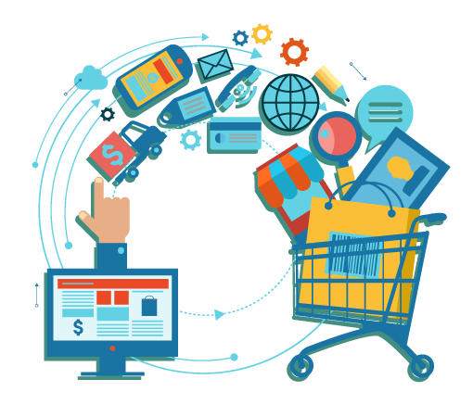
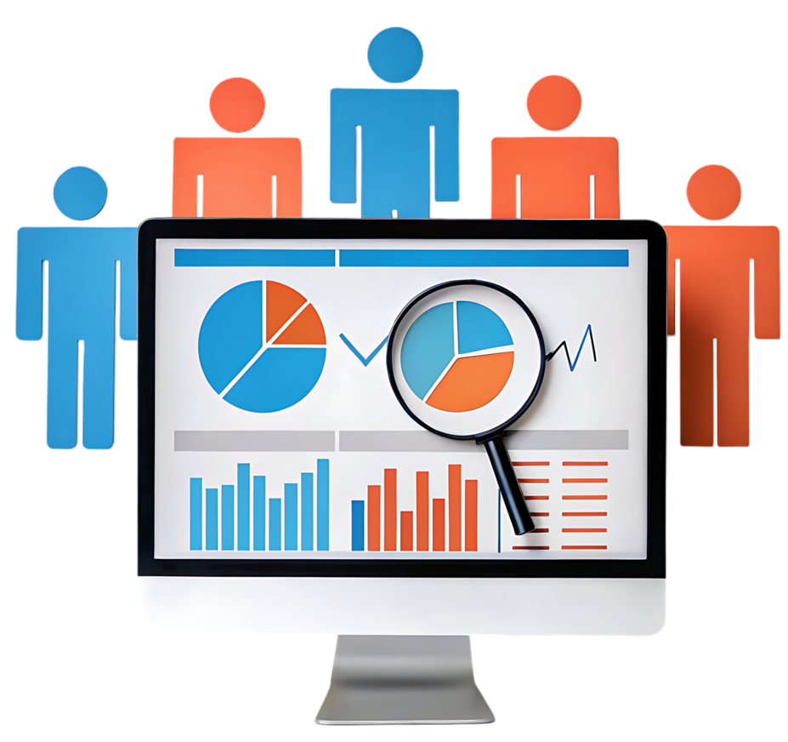
UK e-Commerce Customer Segmentation
Daud Rusyad Nurdin

Slide 2



Introduction
My name is Daud Rusyad Nurdin (Daud). Coming from Bandung, I’m an IT practitioner in Jakarta and live in Tangerang Selatan. I used to play futsal and badminton, but retired. Reading any kind of topics book and learning something new is my hobby. Maybe because I think I’m a curious man.
Graduated my bachelor in Informatics (Information Technology), then while I was working I continued my magister program in Management, with a specialization in International Business.
Starting out as a programmer, then I've worked extensively in data processing and have been involved in several data warehouse and business intelligence projects. I'm currently interested in data science, and I plan to delve deeper into AI programming and Generative AI. My colleagues say I'm a very detailed and meticulous person. My work principle: correct, fast, and neat.
2

Slide 3
Project:
UK e-commerce Customer Segmentation
Project Background
Business Problem
Data Understanding
Data Analysis and Insights
Dashboards and Visualizations
Recommendations and Actionable Insights

Slide 4
Project Background
From the past to the present, customers remain a crucial factor in the success of any business. And the motto "The customer is king" remains relevant today.
This project will analyze UK e-commerce transaction data to identify consumer segmentation based on several categories within the data.
RFM analysis will be performed on this data to identify customer segments using this popular and widely used method. This allows for accurate customer segmentation and provides recommendations & actionable insights for each segment.
With the recommendations provided, it is hoped that the level of customer satisfaction and customer retention can be increased and "lost" customers can be brought back.
4

Slide 5
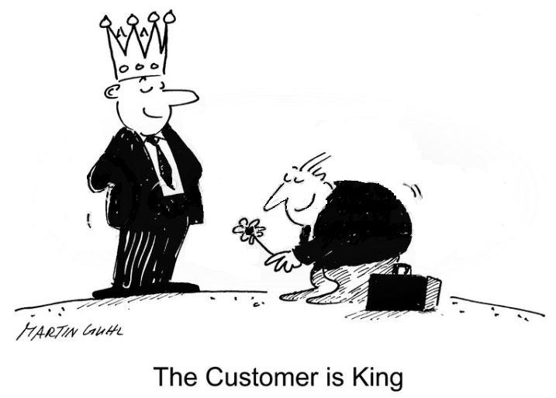
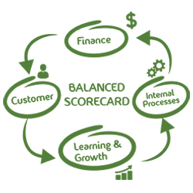
Business Problem
In today's competitive business environment, customers are a company's most valuable asset. The principle "The customer is king" emphasizes that customers play a central role in determining a company's success. By understanding and meeting customer needs, companies can increase customer satisfaction and build strong loyalty.
From Balanced Scorecard perspective, customer satisfaction is a crucial aspect in measuring company performance. By prioritizing customer satisfaction, companies can increase revenue, retain customers, and enhance their reputation.
5

Slide 6
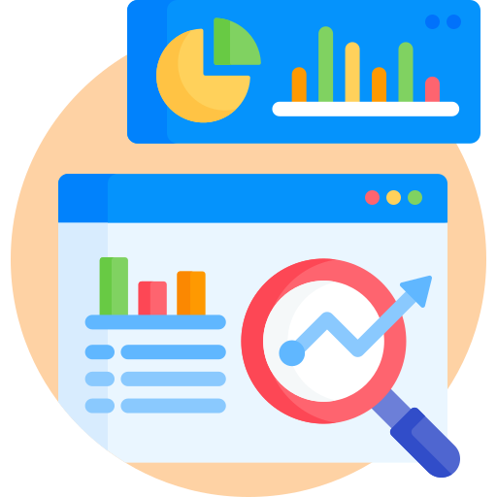
Data Understanding

Slide 7
Data Source and its Structure
Data Source: uk_ecommerce.csv*)
Data structure:
7
*) https://www.kaggle.com/code/calvinsinaalkhazhaj/eda-uk-ecommerce-analysis

Slide 8
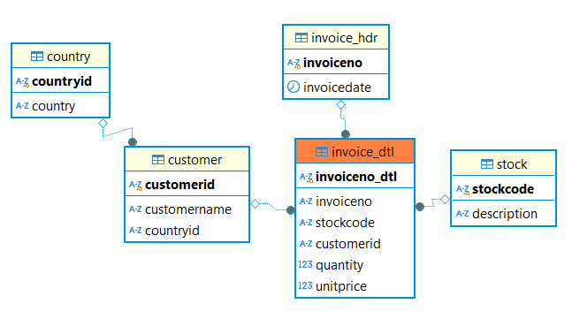
Entity Relationship Diagram
8

Slide 9
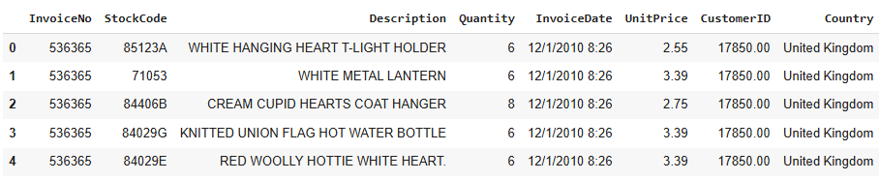
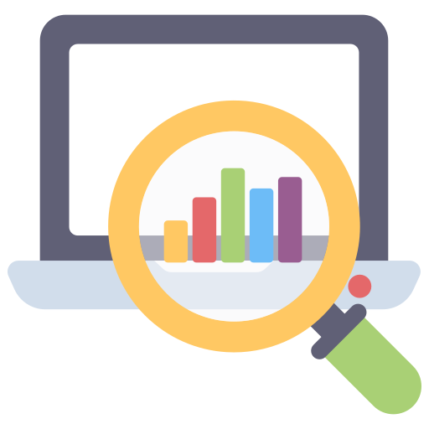
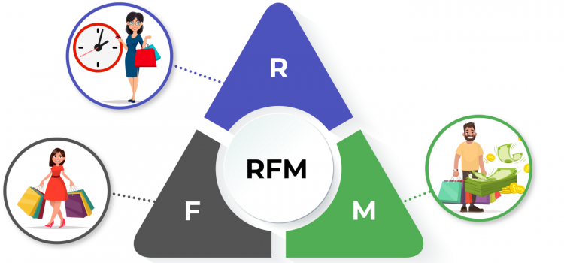
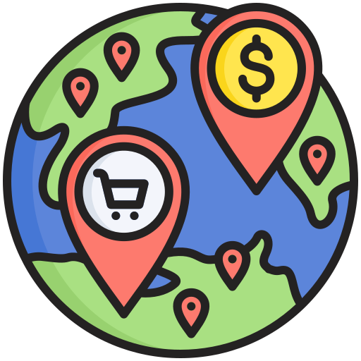
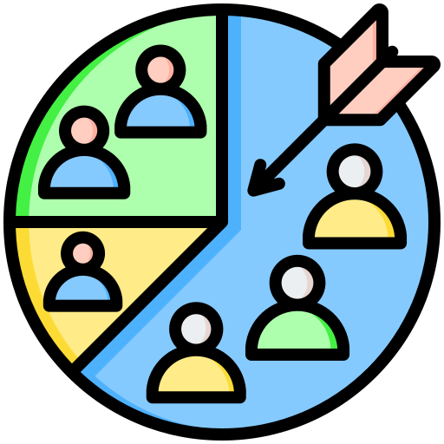
Data Sample
9

Slide 10

Data Cleansing

Slide 11
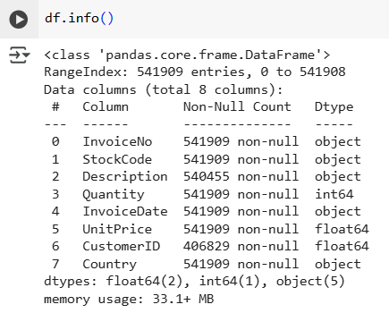

Global information of data
Information obtained:
Total record: 541,909 rows; total column: 8 columns.
There are two columns that contain Null values, namely: (1) Description; and (2) CustomerID → Data cleaning is required.
It would be better to transform data type of CustomerID from float to object.
11

Slide 12
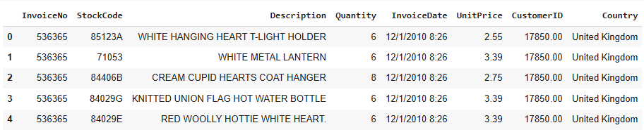
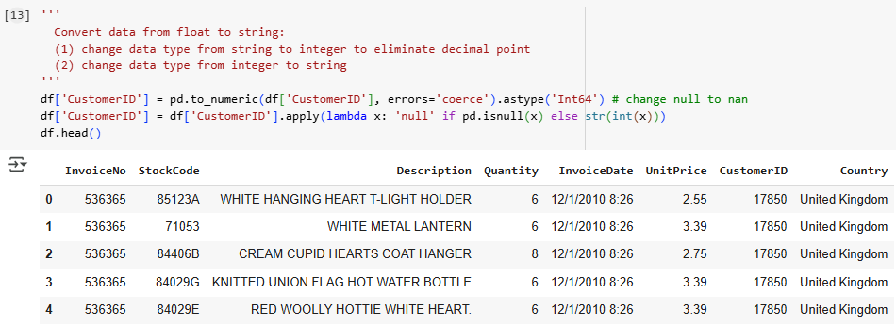
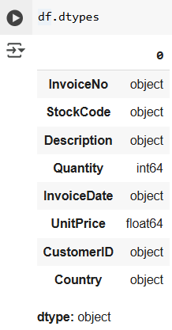
Change data type of CustomerID
Before
After
12

Slide 13
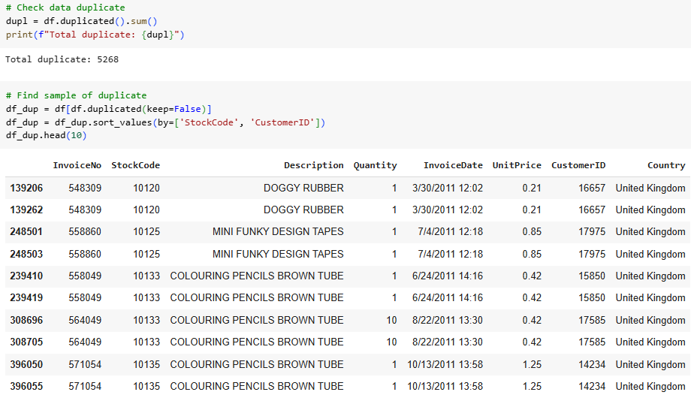
Data Duplicate
Total duplicate: 5268 rows
→ Need to deduplicate
13

Slide 14
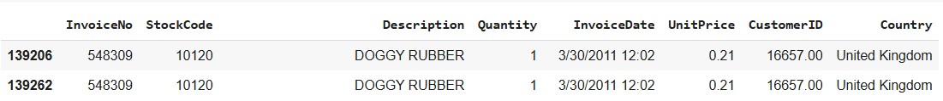
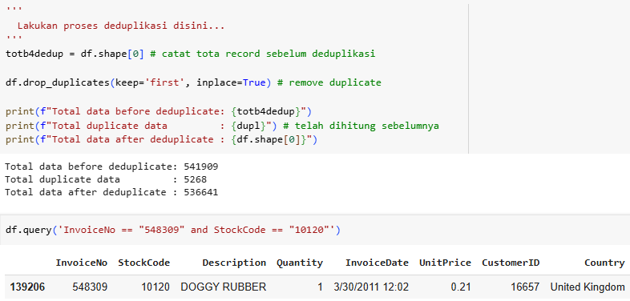
Remove Duplicate
Before
After
After removing duplicate data, there are 536,641 rows of data left.
14

Slide 15
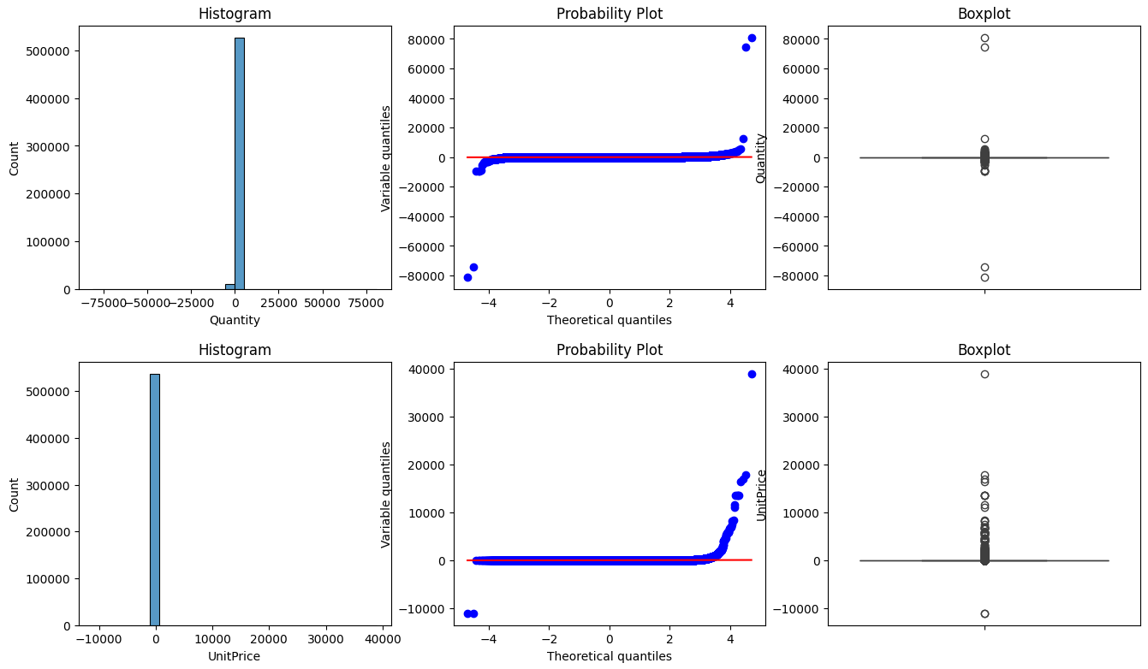
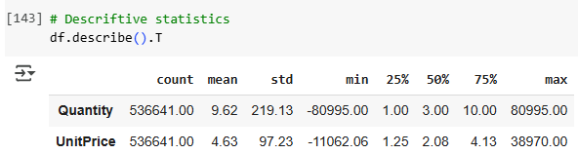
Outliers
Before
Remove outliers
15

Slide 16
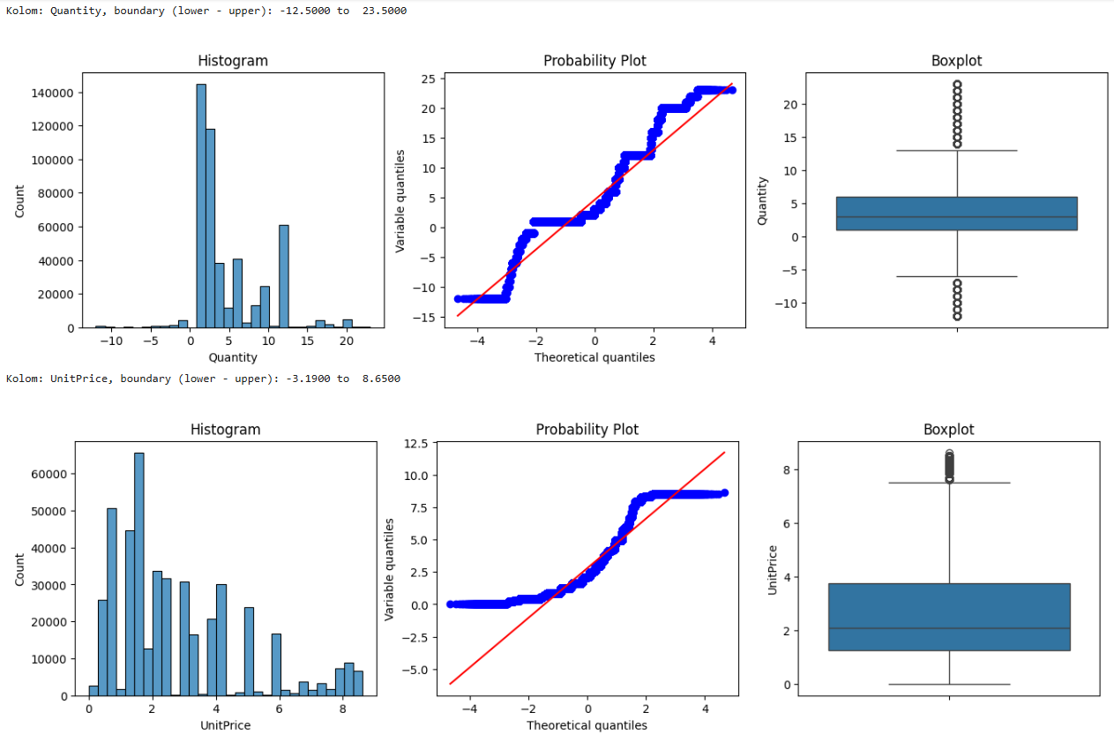
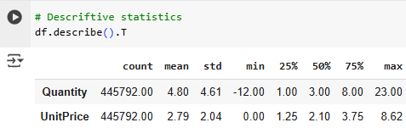
Remove Outliers
After
After removing outliers, there are 445,792 rows of data left.
16

Slide 17
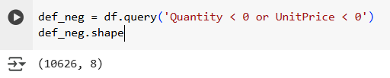
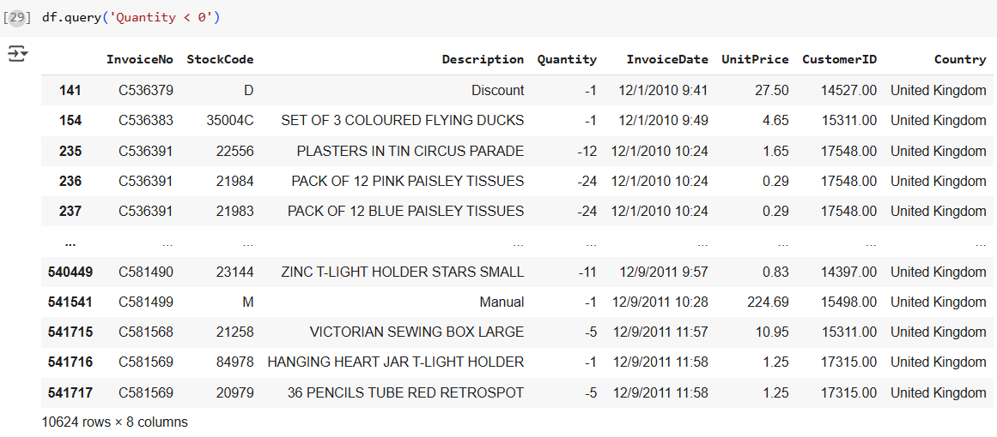
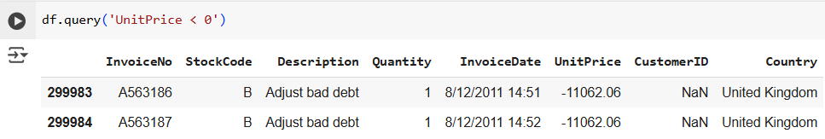
Negative value of Quantity and UnitPrice
Negative values in Quantity and UnitPrice are present, likely due to cancelled transactions. *)
Remove the data → not relevant
17
*) https://www.kaggle.com/code/duygujones/customer-behaviour-analysis-eda-rfm-pca

Slide 18
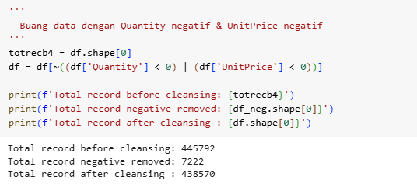
Remove cancelled transaction
18

Slide 19
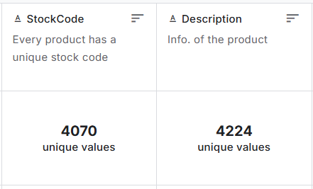
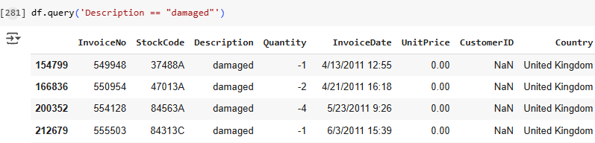
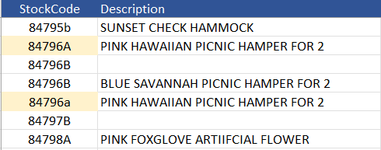
Anomaly Data
*) Data Sample
There is no constraint validation in the source data database table.
Transform StockCode → Use function Upper()
19

Slide 20
Anomaly Data
From the description information it seems that this data is not real sales transaction data.
This type of data will be excluded from the dataset.
Remove this data.
20

Slide 21
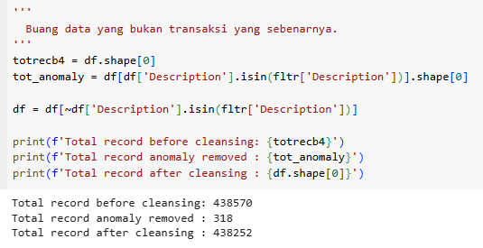
Remove anomaly data
Methodology:
Identify information of column Description suspected of representing anomaly data.
This data is stored in a CSV file as a reference for removing this anomaly data.
Remove anomaly data.
21

Slide 22
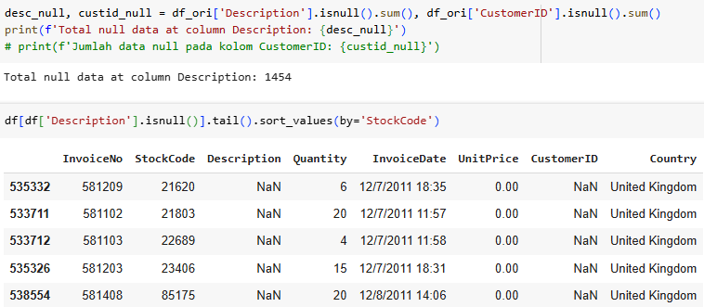
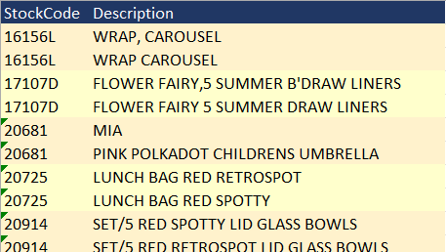
Missing Values : “Description”
- There 1,454 records missing values
- Some of the same StockCode have similar, but not exactly the same Description.
22

Slide 23
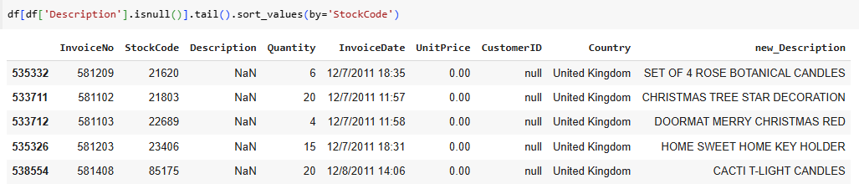
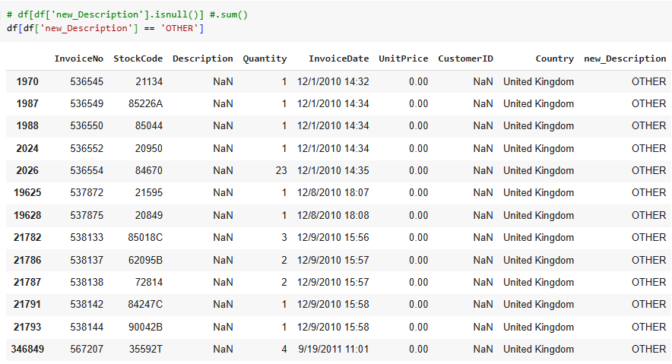
Find new value of “Description”
After
Before
Methodology:
Create standard reference of Description generated from data source.
Look up the value using key: StockCode
Only 13 of 1,454 records failed to map, and filled by “OTHER"
23

Slide 24
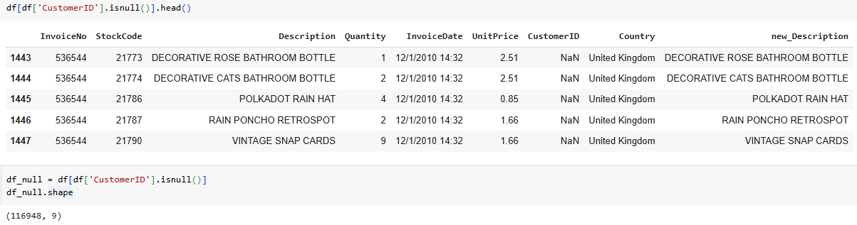
Missing Values : “CustomerID”
Total missing value “CustomerID” = 135,080 (before data cleansing) from total data = 541,909 → 24.9%
Because the value is needed for analysis purposes, the value of the "CustomerID" column cannot be ignored, even though the percentage is > 20%.
Imputation using the mode approach cannot be done, because the number of missing values is quite large so it can cause bias.
For this reason, another approach is needed to obtain the missing value of "CustomerID" by using the KNN (K-Nearest Neighbors) method.
24

Slide 25
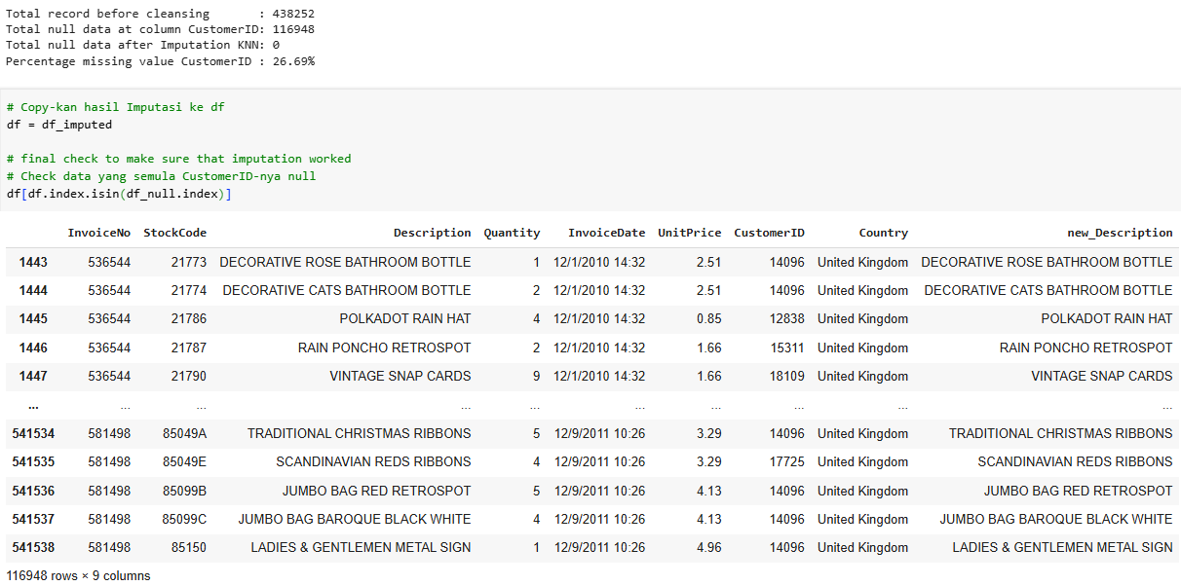
Imputation “CustomerID”
25

Slide 26
Summary of Data Cleansing
Original data set = 541,909
541,909
Change format CustomerID: float → integer → string
536,641
5,268
Remove duplicate
445,792
90,849
Remove outliers, using method: Interquartile Range
438,570
7,222
Remove negative Quantity --> cancelled transaction
438,252
318
Remove anomaly data: by Description
438,252
Imputation missing values: Description & CustomerID
26

Slide 27
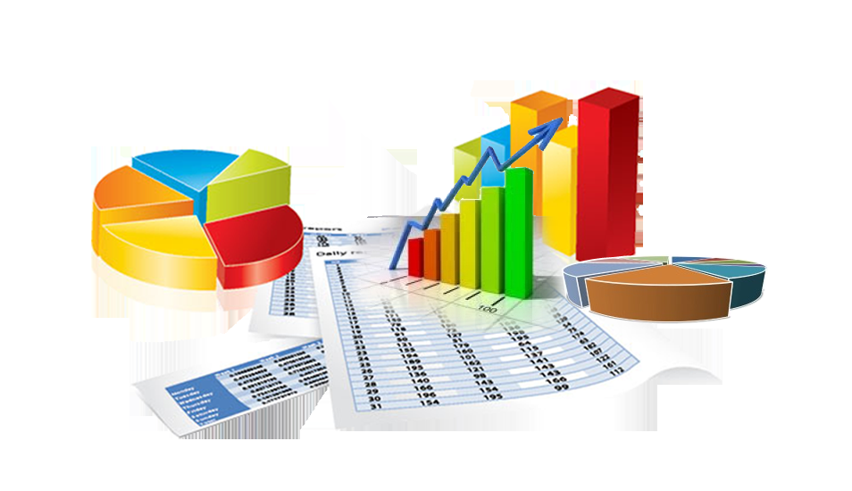
Data Analysis
and Insights

Slide 28
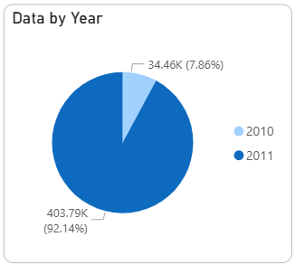
Data Completeness and Cleaness
There are two years of data, namely: 2010 and 2011. However, the 2010 data is incomplete. So, in the next analysis only 2011 data was used.
The data used is not clean, so it is necessary to carry out data cleansing using various methods and assumptions.
The data cleansing carried out includes:
changing data types (CustomerID) & string column case standardization (StockCode)
Removing: duplicate data, outliers, canceled transactions and anomalous data
data imputation by looking up to the reference table (Description) and KNN method (CustomerID).
Of the total 541,909 rows of original data, after data cleansing, 438,252 rows of data remained, or approximately 80.87%.
28

Slide 29
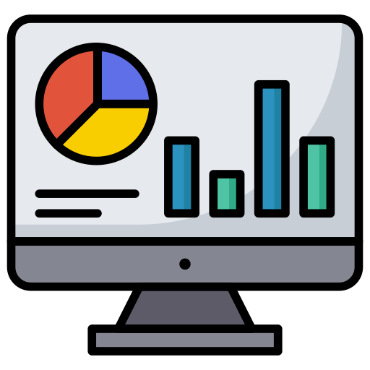
Data Visualization
(Dashboard)

Slide 30
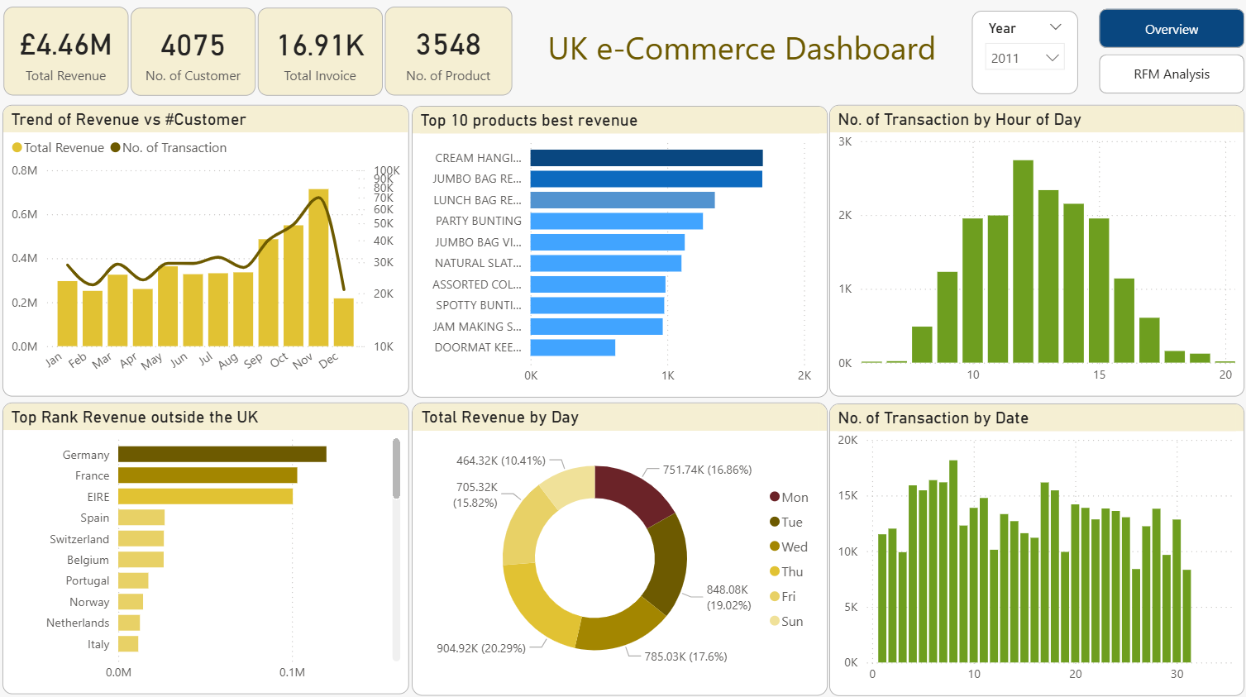
Overview
30

Slide 31
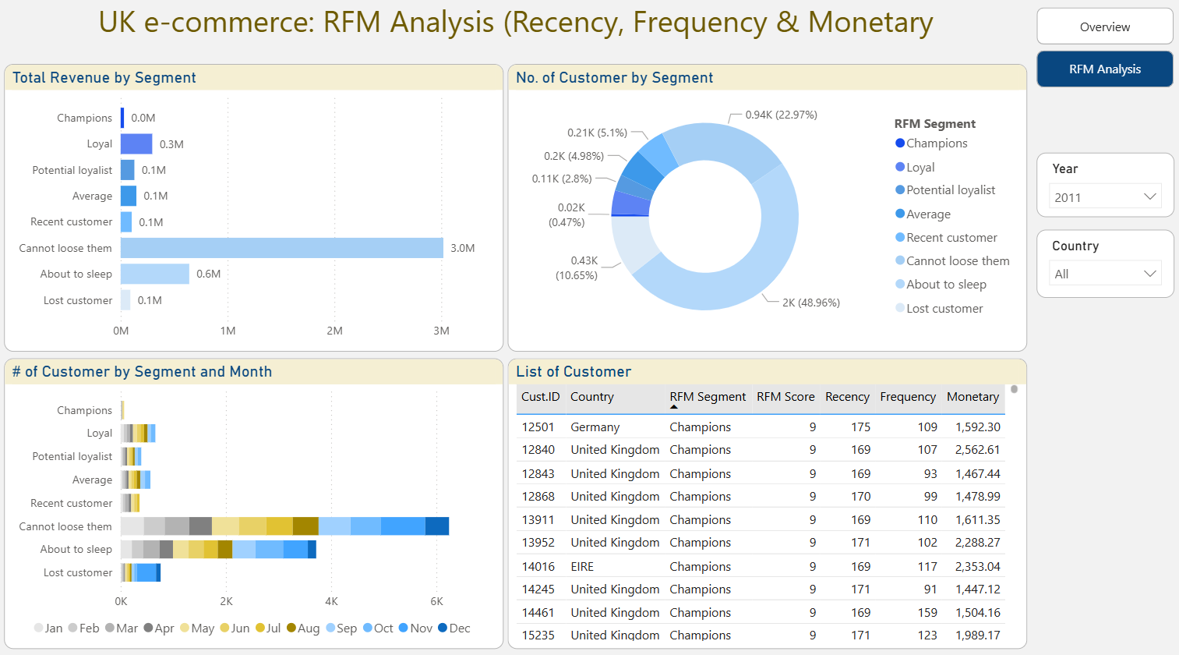
RFM Analysis
31

Slide 32
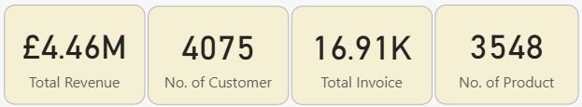
Global values
The total revenue of e-commerce businesses is quite large and is increasing day by day, due to technological developments and changes in consumer behavior.
The level of public trust in online shopping is increasing due to improved service, security and convenience when making transactions.
Because of this, currently many companies are doing various ways to attract customer interest, such as: providing discounts, cashback, easy payment methods, free shipping, and even personalized product offers.
By getting a good shopping experience, it is hoped that customers will stay and become a positive story to attract other new customers.
32

Slide 33
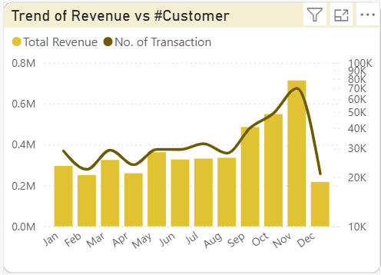
Trend of revenue compared to # transcation
Product sales increased significantly at the end of the year, especially in the period from September to November.
This happened, perhaps because September started the winter season and Christmas and New Year celebrations, so that people's spending during that month increased.
It's the right time for sellers on e-commerce platforms to provide sales incentives to customers, such as providing special discounts, bonuses or appropriate product offers.
33

Slide 34
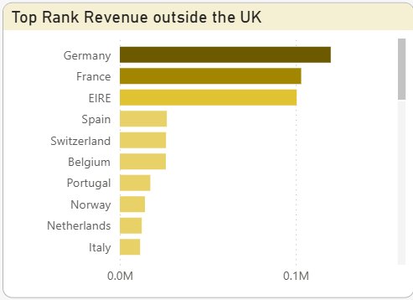
Top rank revenue gained outside the UK
The 10 countries outside the UK that make the biggest contribution to revenue are relatively close by, except perhaps Spain and Portugal.
This fact can be a consideration when expanding the business. Local factors in each country need to be considered to ensure effective and efficient market penetration.
34

Slide 35
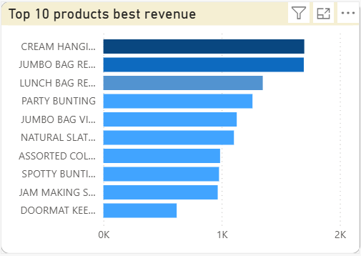
Top rank revenue gained outside the UK
For the most purchased top products, it's necessary to further study why these types of products sell best. It's also important to examine whether the public's demand for these products has been met.
If possible, it's possible to import these products from countries with lower production costs, such as China, Bangladesh, or Indonesia, to meet market demand.
Most importantly, quality control can be maintained, given that Europeans are quite concerned about quality, including copyright.
35

Slide 36
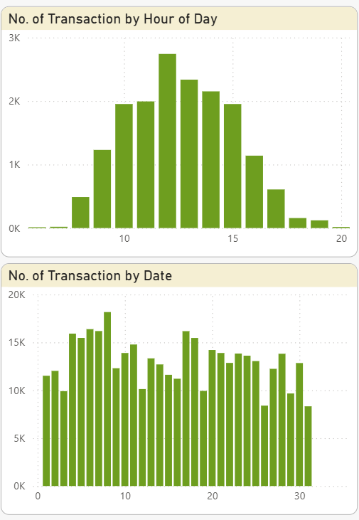
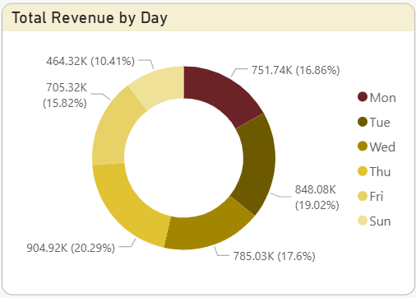
Transaction by Day/ Date & Revenue by Day
Transactions are carried out during normal hours of the day, especially in the middle of the day when all employees are taking a break from work.
There are no significant differences between consumer shopping days, except for Saturday, where, according to available data, there are no transactions on that day.
People tend to shop at the beginning of the month, especially from the 1st to the 8th, perhaps because most people receive their monthly salary at the end of the month.
36

Slide 37
RFM Analysis Customer Segmentation
37

Slide 38
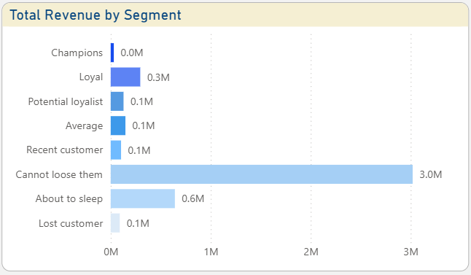
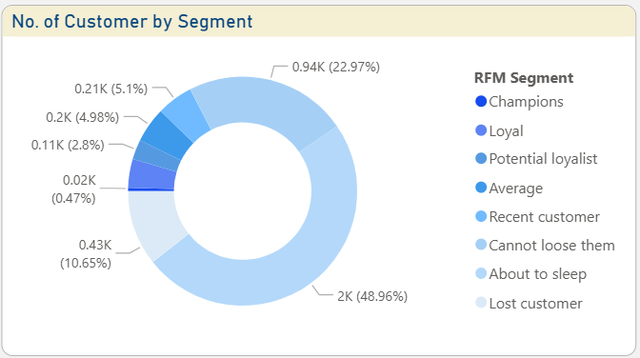
Revenue and no. of customer
The largest spending segments come from "Cannot Lose Them" and "About to Sleep," accounting for approximately 81%. The "Lost Customer" segment accounts for 2%, contributing revenue. The remaining 17% is spread across other segments.
In terms of number of customers, 83% of the revenue was obtained from segments with around 82.6% of customers.
However, in terms of number of subscribers, the "About to Sleep" segment covers 48.96% of the total subscribers.
38

Slide 39

Recommendations and Actionable Insights

Slide 40
Champions (0.47%)
Recommendation | Actionable Insights
Personalization: Provide a personalized shopping experience by offering products relevant to their interests and preferences. Loyalty Program: Create a loyalty program exclusive to the Champion segment, with greater and faster rewards. Effective Communication: Ensure effective and regular communication with the Champion segment, through their preferred channels (email, SMS, or social media). Exclusive Products: Offer exclusive or limited-edition products available only to the Champion segment. Premium Customer Service: Provide premium and responsive customer service to ensure their satisfaction. | Behavioral analysis: Analyze the purchasing behavior of the Champion segment to understand their purchasing patterns and preferences. Further segmentation: Further segment this Champion segment based on behavior, demographics, or preferences to enhance personalization. Product development: Develop products that align with the needs and preferences of the Champion segment. ROI measurement: Measure the ROI of loyalty and personalization programs to ensure the effectiveness of these investments. Retention strategy development: Develop an effective retention strategy to retain the Champion segment and prevent them from switching to competitors.
40

Slide 41
Loyal (4.07%)
Recommendation | Actionable Insights
Targeted promotions: Offer promotions that are relevant and attractive to the Loyal segment, such as special discounts, free shipping, gifts and exclusive access. Effective communication: Ensure effective and regular communication with the Loyal segment, through their preferred channels (email, SMS, or social media). Loyalty rewards: Reward the Loyal segment for their loyalty, such as access to exclusive products or special events. Product development: Develop products that meet the needs and preferences of the Loyal segment. Good customer service: Provide good and responsive customer service to ensure their satisfaction. | Behavioral analysis: Analyze the purchasing behavior of the Loyal segment to understand their purchasing patterns and preferences. Further segmentation: Further segment this Loyal segment based on behavior, demographics, or preferences to enhance personalization. ROI measurement: Measure the ROI of promotions and loyalty programs to ensure the effectiveness of these investments. Retention strategy development: Develop effective retention strategies to retain the Loyal segment and prevent them from switching to competitors. Data utilization: Use customer data to predict the needs and preferences of the Loyal segment and offer relevant products.
41

Slide 42
Potential loyalist (2.8%)
Recommendation | Actionable Insights
Effective communication: Ensure effective and regular communication with the Potential Loyalist segment, through their preferred channels (email, SMS, or social media). Purchase rewards: Provide rewards for their purchases, such as discounts or small gifts. Product recommendations: Provide product recommendations relevant to their interests and preferences. Relationship development: Develop relationships with the Potential Loyalist segment through positive and responsive interactions. Satisfaction measurement: Measure the satisfaction of the Potential Loyalist segment to ensure they are satisfied with their purchasing experience. | Behavioral analysis: Analyze the purchasing behavior of the Potential Loyalist segment to understand their purchasing patterns and preferences. Further segmentation: Further segment this Potential Loyalist segment based on behavior, demographics, or preferences to enhance personalization. Data utilization: Use customer data to predict the needs and preferences of the Potential Loyalist segment and offer relevant products. Retention strategy development: Develop an effective retention strategy to retain the Potential Loyalist segment and prevent them from switching to competitors. ROI measurement: Measure the ROI of the retention and personalization programs to ensure the investment is effective.
42
Retention tactics: (1) Welcome email; (2) Special discounts; (3) Educational content; (4) Satisfaction surveys; (5) Loyalty rewards

Slide 43
Average (4.98%)
Recommendation | Actionable Insights
Relationship development: Develop relationships with the Average segment through positive and responsive interactions. Product recommendations: Provide product recommendations relevant to their interests and preferences. Appropriate promotions: Offer targeted promotions to increase purchase frequency and value. Satisfaction measurement: Measure the satisfaction of the Average segment to ensure they are satisfied with the purchasing experience. Retention strategy development: Develop effective retention strategies to retain the Average segment and prevent them from switching to competitors. | Behavioral analysis: Analyze the purchasing behavior of the Average segment to understand their purchasing patterns and preferences. Further segmentation: Further segment the Average segment based on behavior, demographics, or preferences to enhance personalization. Data utilization: Use customer data to predict the needs and preferences of the Average segment and offer relevant products. ROI measurement: Measure the ROI of retention and personalization programs to ensure the investment is effective. Content development: Develop relevant and engaging content for the Average segment, such as blogs, videos, or social media.
Retention tactics: (1) Email newsletter; (2) Special discounts; (3) Loyalty rewards; (4) Satisfaction surveys; (5) Loyalty program development
43

Slide 44
Recent customer (5.1%)
Recommendation | Actionable Insights
Effective communication: Ensure effective and regular communication with the Recent Customer segment, through their preferred channels (email, SMS, or social media). Purchase rewards: Provide rewards for their purchases, such as discounts or small gifts. Product recommendations: Provide product recommendations relevant to their interests and preferences. Relationship building: Develop relationships with your Recent Customer segment through positive and responsive interactions. Satisfaction measurement: Measure the satisfaction of the Recent Customer segment to ensure they are satisfied with their purchasing experience. | Behavioral analysis: Analyze the purchasing behavior of the Recent Customer segment to understand their purchasing patterns and preferences. Further segmentation: Further segment this Recent Customer segment based on behavior, demographics, or preferences to enhance personalization. Data utilization: Use customer data to predict the needs and preferences of the Recent Customer segment and offer relevant products. Retention strategy development: Develop an effective retention strategy to retain the Recent Customer segment and prevent them from switching to competitors. ROI measurement: Measure the ROI of the retention and personalization programs to ensure the investment is effective.
44
Retention tactics: (1) Email newsletter; (2) Special discounts; (3) Loyalty rewards; (4) Satisfaction surveys; (5) Loyalty program development

Slide 45
Cannot loose them (22.97%)
Recommendation | Actionable Insights
Inactivity Cause Analysis: Analyze the causes of inactivity in the Cannot Lose Them segment to understand what is preventing them from returning. Effective Communication: Ensure effective and regular communication with the Cannot Lose Them segment, through their preferred channels (email, SMS, or social media). Loyalty Rewards: Reward the Cannot Lose Them segment for their past loyalty. Special Offers: Offer special and exclusive offers to win back the Cannot Lose Them segment. Retention Strategy Development: Develop an effective retention strategy to retain and win back the Cannot Lose Them segment. | Further segmentation: Further segment the Cannot Lose Them segment based on behavior, demographics, or preferences to enhance personalization. Data utilization: Use customer data to predict the needs and preferences of the Cannot Lose Them segment and offer relevant products. ROI measurement: Measure the ROI of retention and personalization programs to ensure the effectiveness of these investments. Content development: Develop relevant and engaging content for the Cannot Lose Them segment, such as blogs, videos, or social media. Satisfaction surveys: Conduct satisfaction surveys to understand the needs and preferences of the Cannot Lose Them segment.
Retention tactics: (1) Exclusive offers; (2) Loyalty rewards; (3) Personal communication; (4) Loyalty program development; (5) Success measurement
45

Slide 46
About to sleep (48.96%)
Recommendation | Actionable Insights
Customer reactivation: Create a reactivation campaign to reactivate the About to Sleep segment by offering special offers and promotions. Effective communication: Ensure effective and regular communication with the About to Sleep segment, through their preferred channels (email, SMS, or social media). Loyalty rewards: Reward past loyalty to increase loyalty. Relevant offers: Offer offers relevant to their interests and preferences to increase the likelihood of purchase. Success measurement: Measure the success of the reactivation campaign to ensure the strategy is effective. | Behavioral analysis: Analyze the purchasing behavior of the About to Sleep segment to understand their purchasing patterns and preferences. Further segmentation: Further segment the About to Sleep segment based on behavior, demographics, or preferences to enhance personalization. Data utilization: Use customer data to predict the needs and preferences of the About to Sleep segment and offer relevant products. Content development: Develop relevant and engaging content for the About to Sleep segment, such as blogs, videos, or social media. ROI measurement: Measure the ROI of the reactivation campaign to ensure the investment is effective.
Reactivation tactics: (1) Discount offers; (2) Loyalty rewards; (3) Personal communication; (4) Loyalty program development; (5) Success measurement
46

Slide 47
Lost customer (10.65%)
Recommendation | Actionable Insights
Loss Cause Analysis: Analyze the causes of customer loss to understand what causes them to not return. Effective Communication: Ensure effective and regular communication with the Lost Customer segment, through their preferred channels (email, SMS, or social media). Relevant Offers: Offer offers relevant to their interests and preferences to increase the likelihood of a purchase. Loyalty Rewards: Reward past loyalty to increase loyalty. Success Measurement: Measure the success of win-back campaigns to ensure the strategies used are effective. | Further segmentation: Further segment the Lost Customers segment based on behavior, demographics, or preferences to enhance personalization. Data utilization: Use customer data to predict the needs and preferences of the Lost Customers segment and offer relevant products. Content development: Develop relevant and engaging content for the Lost Customers segment, such as blogs, videos, or social media. ROI measurement: Measure the ROI of your win-back campaign to ensure the investment is effective. Win-back strategy development: Develop an effective win-back strategy to retain the Lost Customers segment and increase loyalty.
Win-back tactics: (1) Discount offers; (2) Loyalty rewards; (3) Personal communication; (4) Loyalty program development; (5) Satisfaction surveys
47

Slide 48
